Slide 1
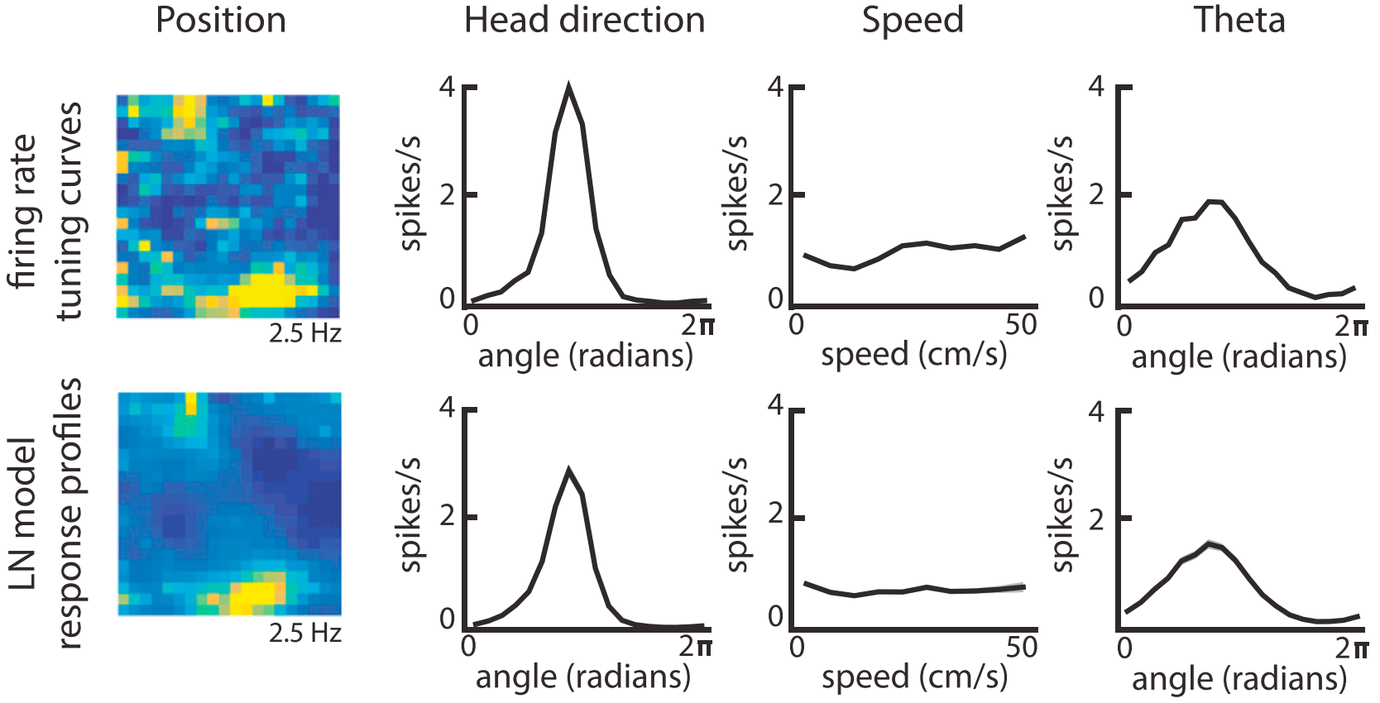
Generalized linear models
Machine Learning from Scratch seminar
John Vastola
2/20/24

Slide 2
Q. What is Machine Learning from Scratch?
A. Occasional HMS seminar focused on learning about ML fundamentals.
Topics might be related to neuro research, or might just be cool!
https://github.com/DrugowitschLab/ML-from-scratch-seminar
first is theory-focused
second is coding-focused
Seminars happen over 2 evenings:
Feb | GLMs (w/ Kiah Hardcastle)
Mar | RNNs (w/ Siyan Zhou)
Apr | TBD
May | TBD
~ Four seminars planned for Spring 2024:

Slide 3
Useful resources for learning about GLMs
Tutorials
2016 SFN tutorial on GLMs by Jesse Kaminsky and Jonathan Pillow
https://github.com/pillowlab/GLMspiketraintutorial_python
Neuromatch Academy GLM tutorial by Fiquet et al.
https://compneuro.neuromatch.io/tutorials/W1D3_GeneralizedLinearModels/student/W1D3_Tutorial1.html
GLM_Tensorflow2 repository by Shih-Yi Tseng
https://github.com/sytseng/GLM_Tensorflow_2
See this session’s GitHub page for more!

Slide 4
Useful resources for learning about GLMs
Example papers
[2014 Park et al.] “Encoding and decoding in parietal cortex during sensorimotor decision-making”
application to data from macaque lateral intraparietal area
https://www.nature.com/articles/nn.3800
[2017 Hardcastle et al.] “A Multiplexed, Heterogeneous, and Adaptive Code for Navigation in Medial Entorhinal Cortex”
application to data from mouse medial entorhinal cortex
https://doi.org/10.1016/j.neuron.2017.03.025
[2022 Tseng and Chettih et al.] “Shared and specialized coding across posterior cortical areas for dynamic navigation decisions”
application to data from mouse posterior cortex
https://doi.org/10.1016/j.neuron.2022.05.012
See this session’s GitHub page for more!

Slide 5
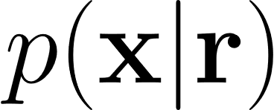

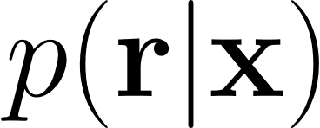
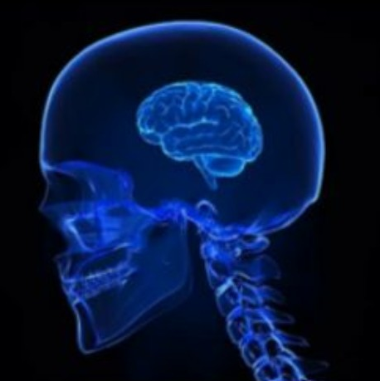
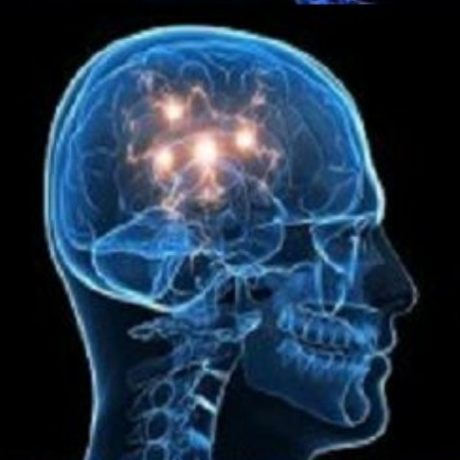
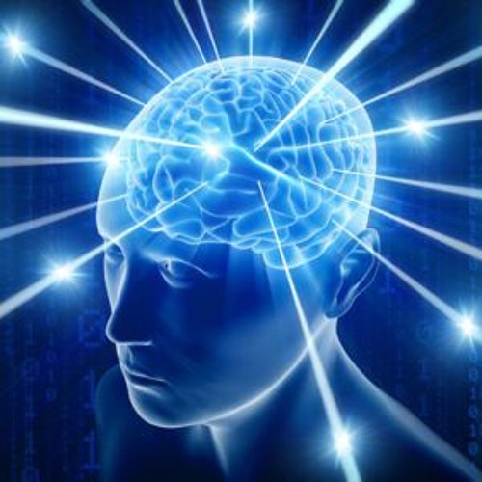
e.g., predicting choices
from neural activity
I I I I I I I I I
I I II I I I I
e.g., predicting activity
from behavior
I I II I I I I II
perception
beliefs
actions
Q. How do we estimate p(r | x) using a mix of neural and behavioral data?
Statistical models
Biophysical models
“Just fit a line!”
RNNs
(next
session!)
“All details matter!”
GLMs
increasing sophistication / realism

Slide 6
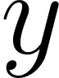

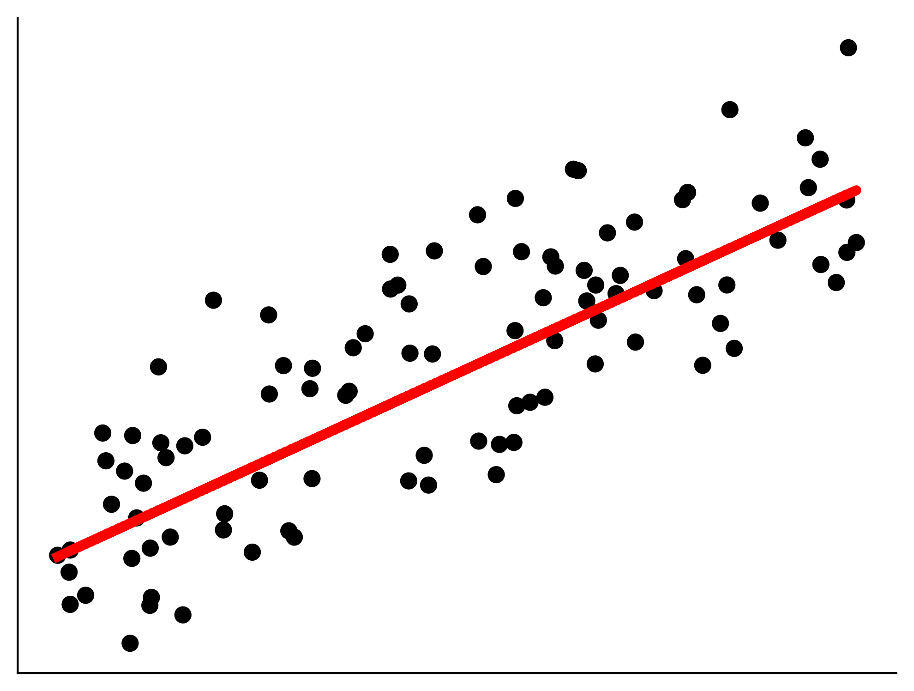

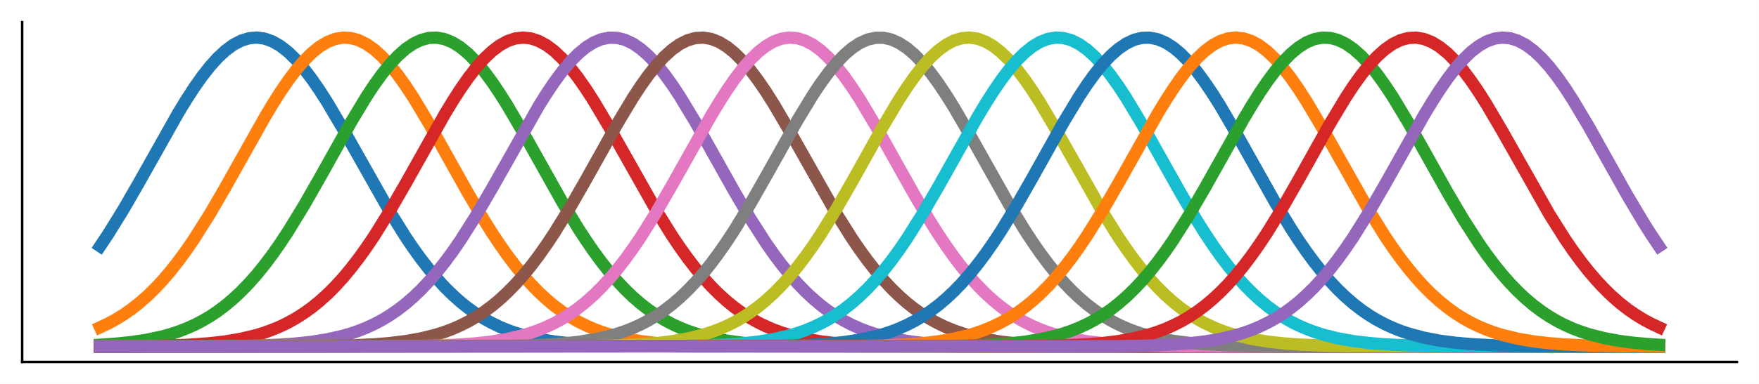
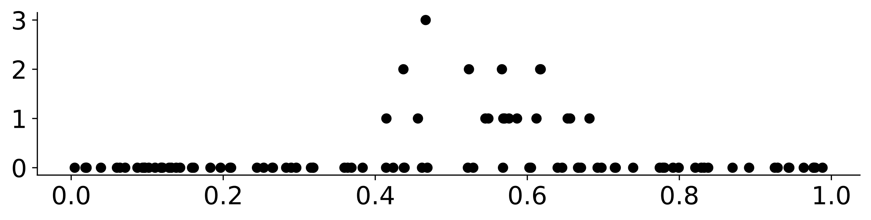

Line is a pretty reasonable choice with various benefits to recommend
Fitting is straightforward, interpretable, etc
Obvious problems: neural activity can’t be negative, usually bounded,
And almost all known models involve some kind of nonlinearity
Solution: just add a nonlinearity to a linear model + emission
Lines are simple + interpretable…
…but not necessarily a good fit for neural data!
f.r. (spikes/s)
position (m)
f.r. (spikes/s)
Solution
position (m)
Need to add nonlinearity to account for, e.g., nonnegativity.
Also need to allow for non-Gaussian (in particular, Poisson-like) noise.

Slide 7
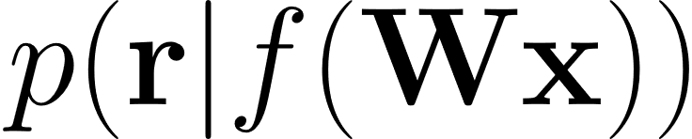


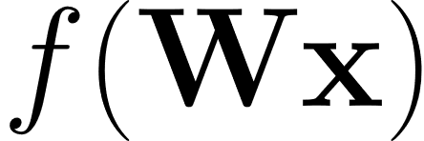

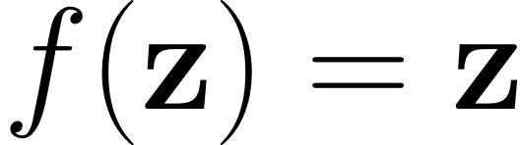
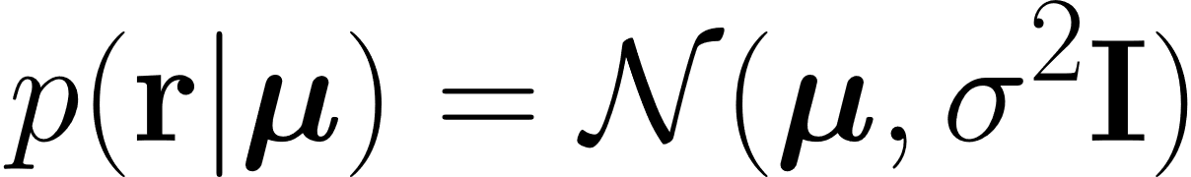
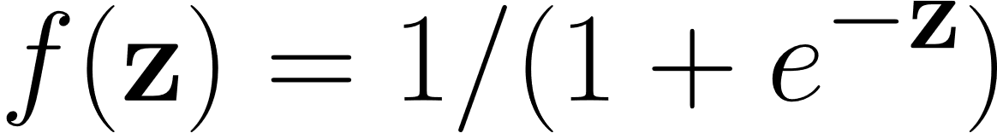
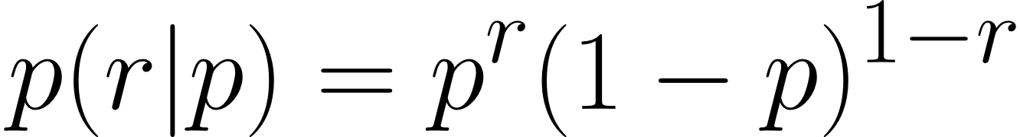

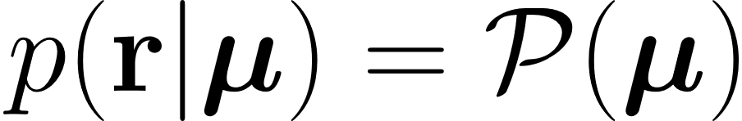
GLMs from a generative modeling perspective
noise model
linear
filter
apply
nonlinearity
input
(percepts, beliefs, actions…)
distribution
parameters
output
(spikes, Ca traces,…)
Examples:
- linear regression
- logistic regression
- Poisson regression
Note for math lovers: These approaches can be unified using the idea of exponential family distributions.
See Murphy, “Probabilistic Machine Learning” Book 1, Ch. 12. https://probml.github.io/pml-book/

Slide 8
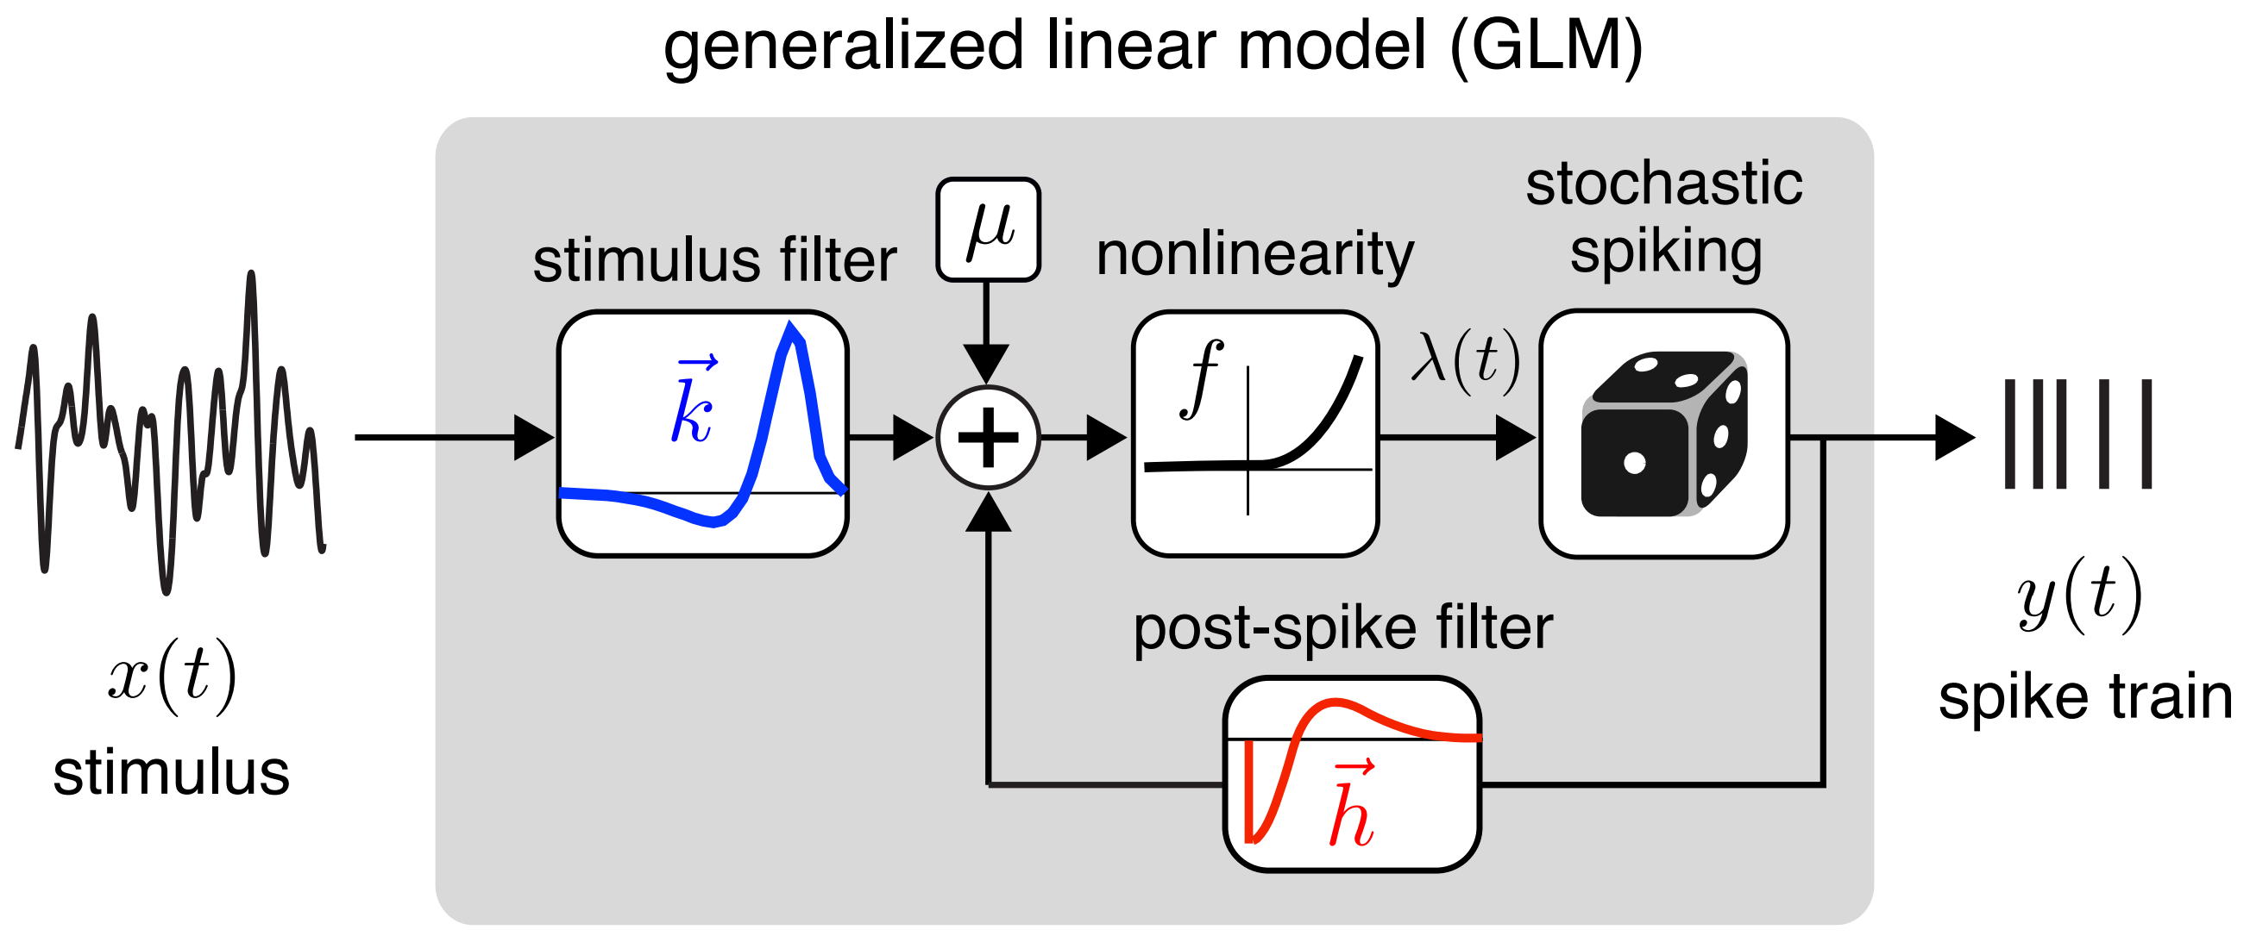
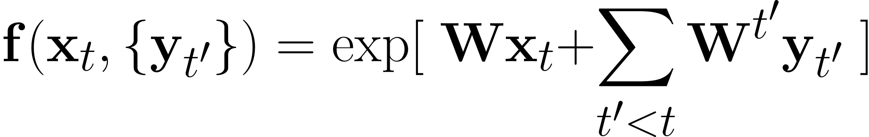
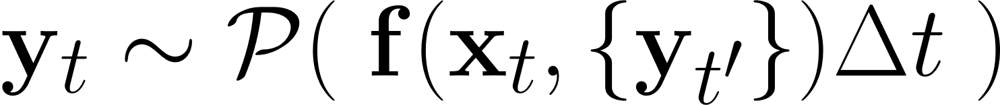
Neuroscience GLMs in practice: linear-nonlinear-Poisson models
Poisson regression (i.e., using an independent Poisson noise model) most commonly used GLM.
The canonical choice of f() is exponential (see exp. family math) but others sometimes used.
Using recent spiking history as input is optional, but helps capture, e.g., bursting, refractory period…
Weber and Pillow, Neur. Comp. (2017)

Slide 9
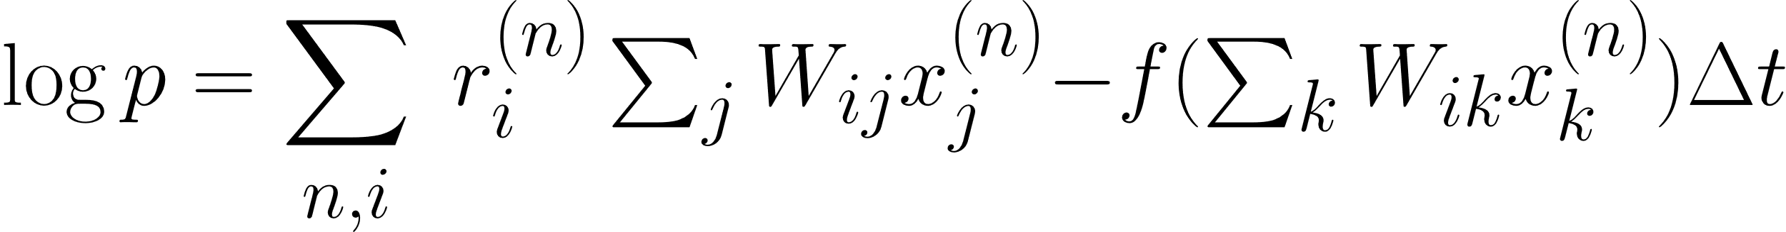
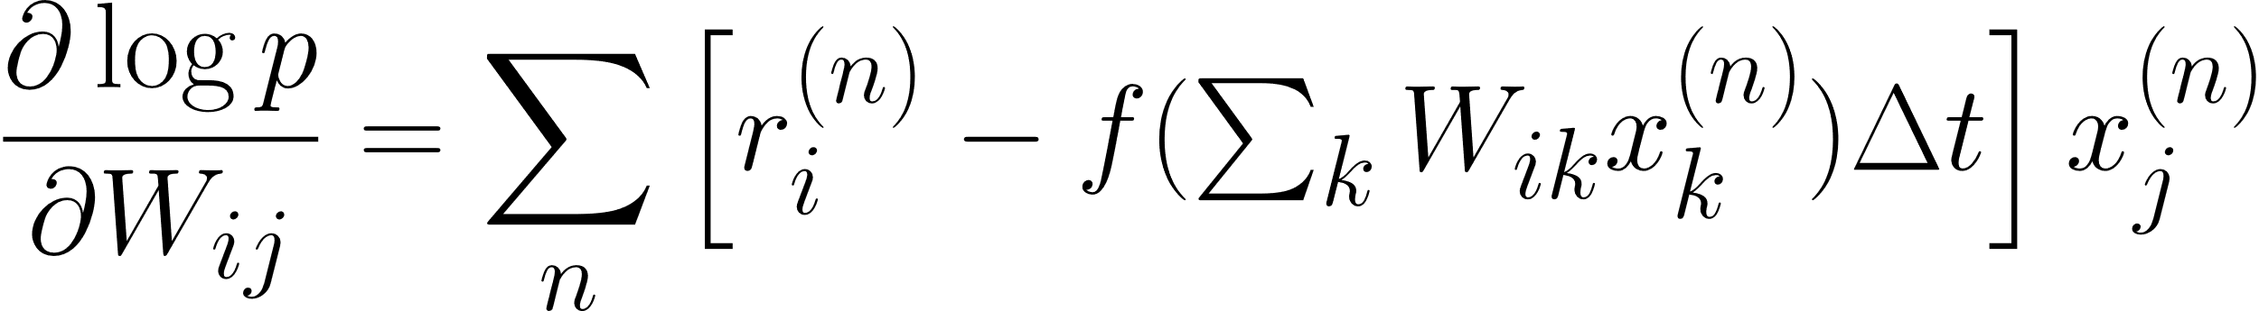
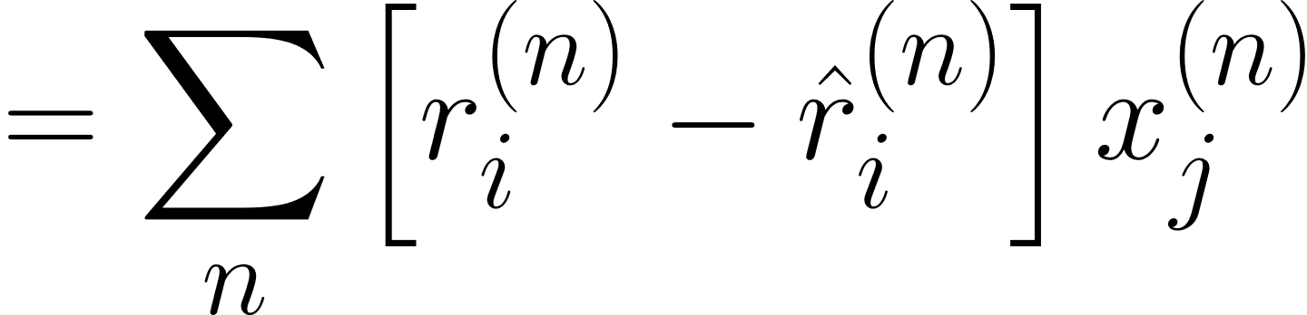
Poisson regression details: likelihood and gradients
Log-likelihood
n: samples, i: neurons, j: inputs
Gradient wrt weights
Note simplicity of expression:
the nth sample contributes a term (true – estimated)*input. Two-factor learning rule!
This holds for more general GLMs with canonical activation functions too. See Murphy.

Slide 10
Example 1: Fitting data from mouse medial entorhinal cortex
Hardcastle et al., Neuron (2017)
“A Multiplexed, Heterogeneous, and Adaptive Code
for Navigation in Medial Entorhinal Cortex”

Slide 11
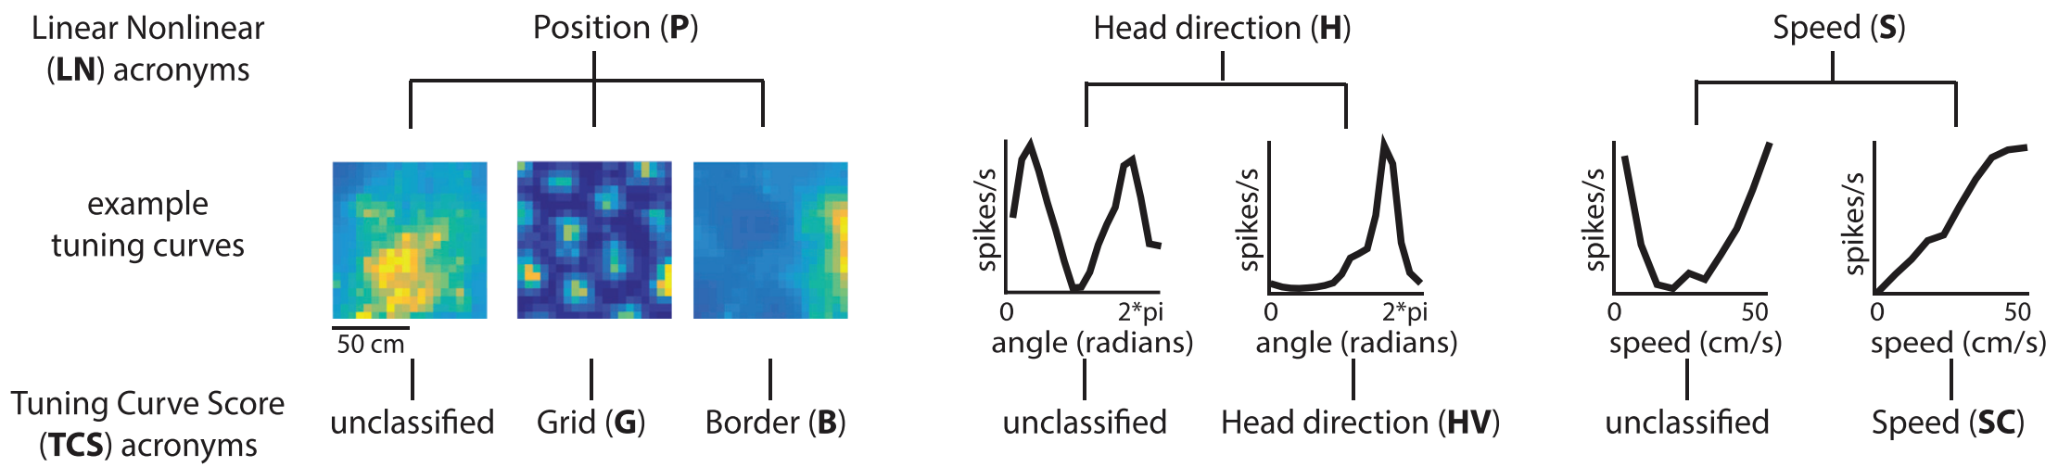
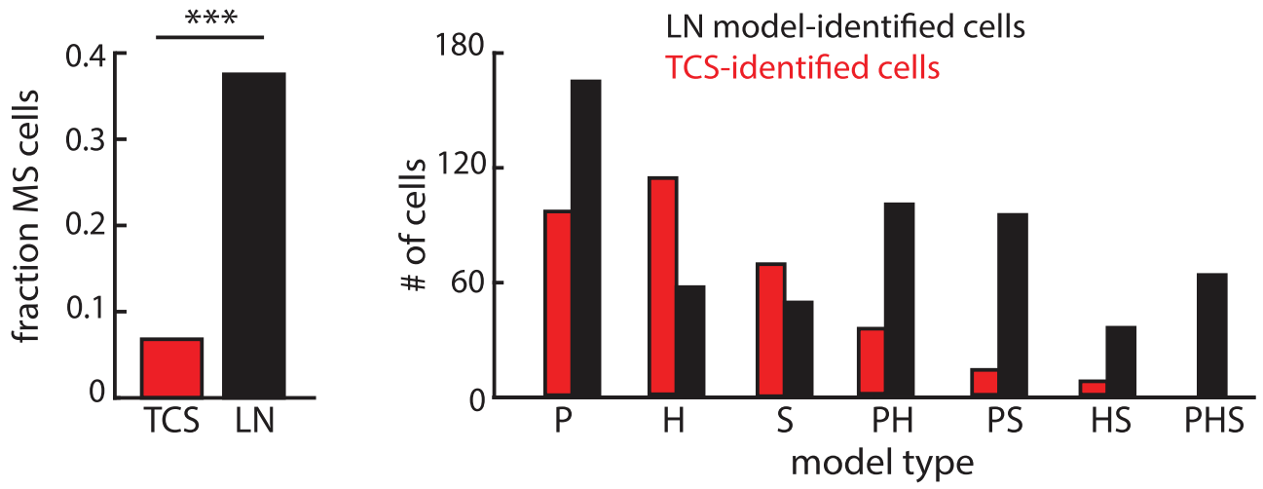
Walk thru concrete neuro example 1: 2017 Hardcastle
Example 1: Fitting data from mouse medial entorhinal cortex
Characterizing cells via GLMs works better!
Hardcastle et al., Neuron (2017)

Slide 12
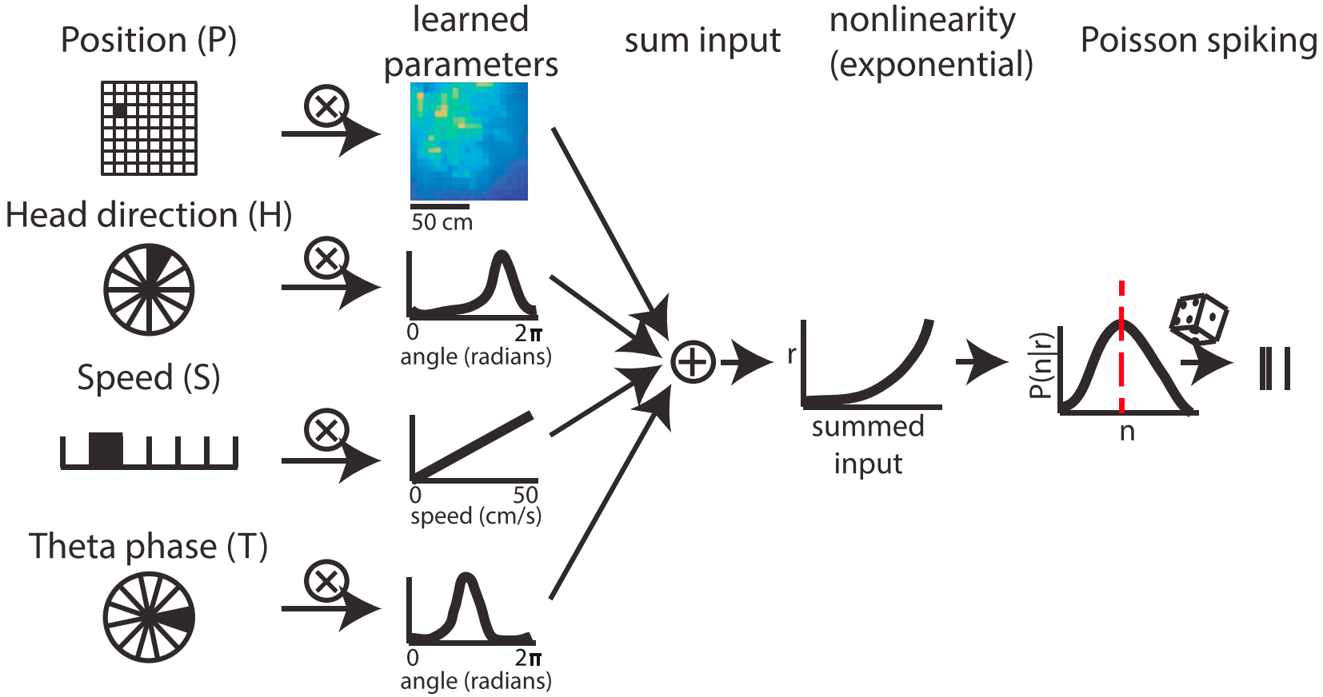
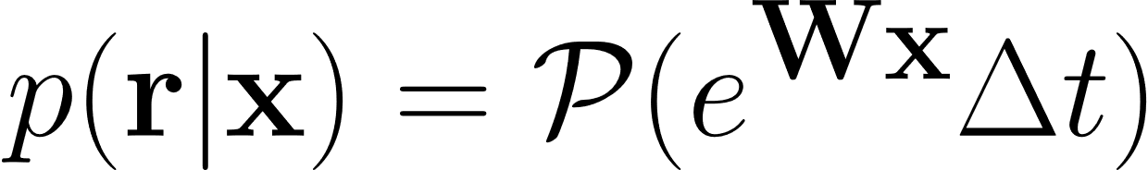
Context, motivation for GLM modeling
Example 1: Fitting data from mouse medial entorhinal cortex
Poisson observations,
exponential activation function
position
head-direction
speed
theta phase

Slide 13
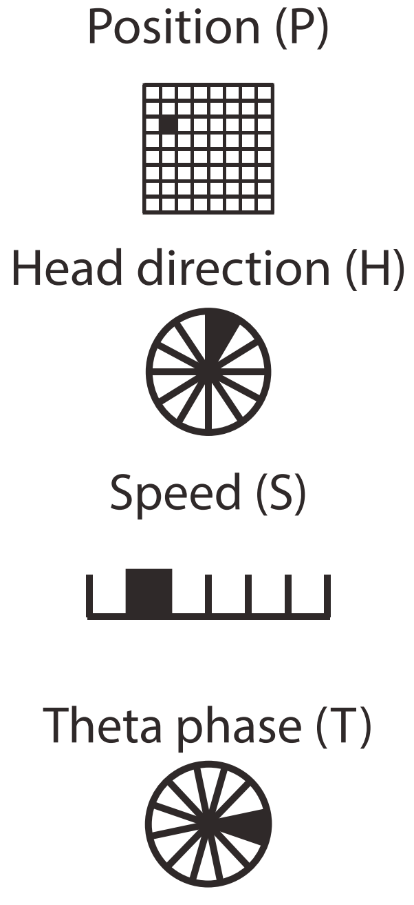
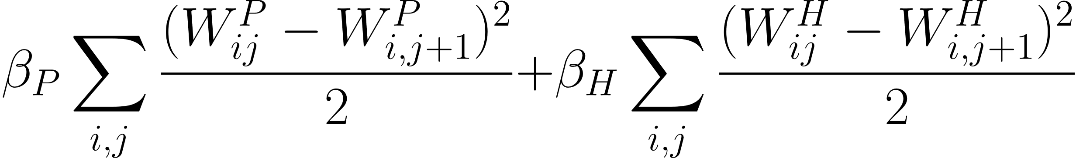
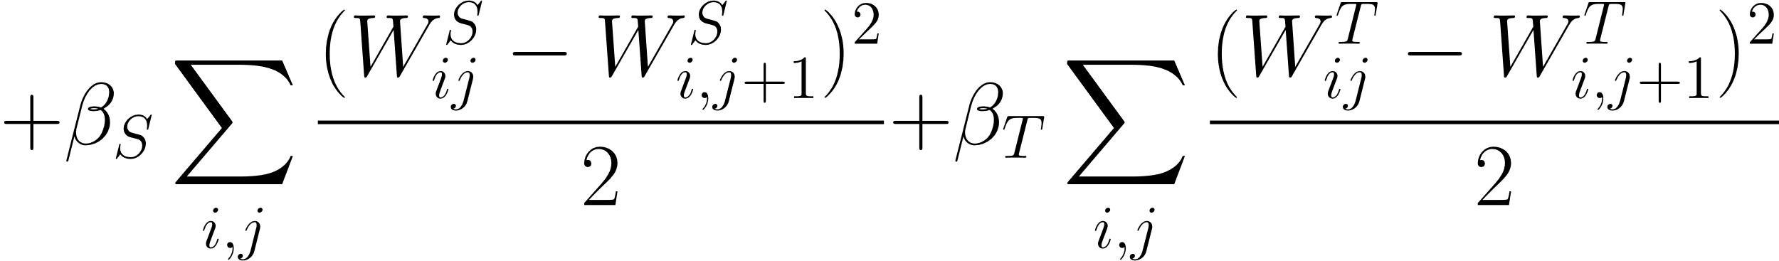
Form of GLM model, details of state representation
Example 1: Fitting data from mouse medial entorhinal cortex
Important fitting detail:
Since behavior encodings are ‘one-hot’, need to regularize objective with
smoothness penalty that ensures firing rates for nearby bins are related:
Beta coefficients control strength of smoothness penalty for each variable.
Fitting detail: impose smoothness by regularizing, otherwise get weird maps;
Necessary given finite data

Slide 14
Example 1 Takeaways
- GLMs provide a statistically unbiased* way to characterize tuning of neurons.
Better way to characterize MEC cells than with grid scores, border scores, etc.
Caveat: depends somewhat on state representation used as input.
Hardcastle et al. use maximally expressive one-hot behavior encodings to avoid issues.
- Regularization is important for avoiding artifacts since data is limited.
Without it, would tend to get weird/discontinuous tuning maps.
Caveat: as we will see, can also address smoothness using a different state representation.

Slide 15
Example 2: Fitting data from mouse posterior cortex
Tseng and Chettih et al., Neuron (2022)
“Shared and specialized coding across posterior
cortical areas for dynamic navigation decisions”

Slide 16
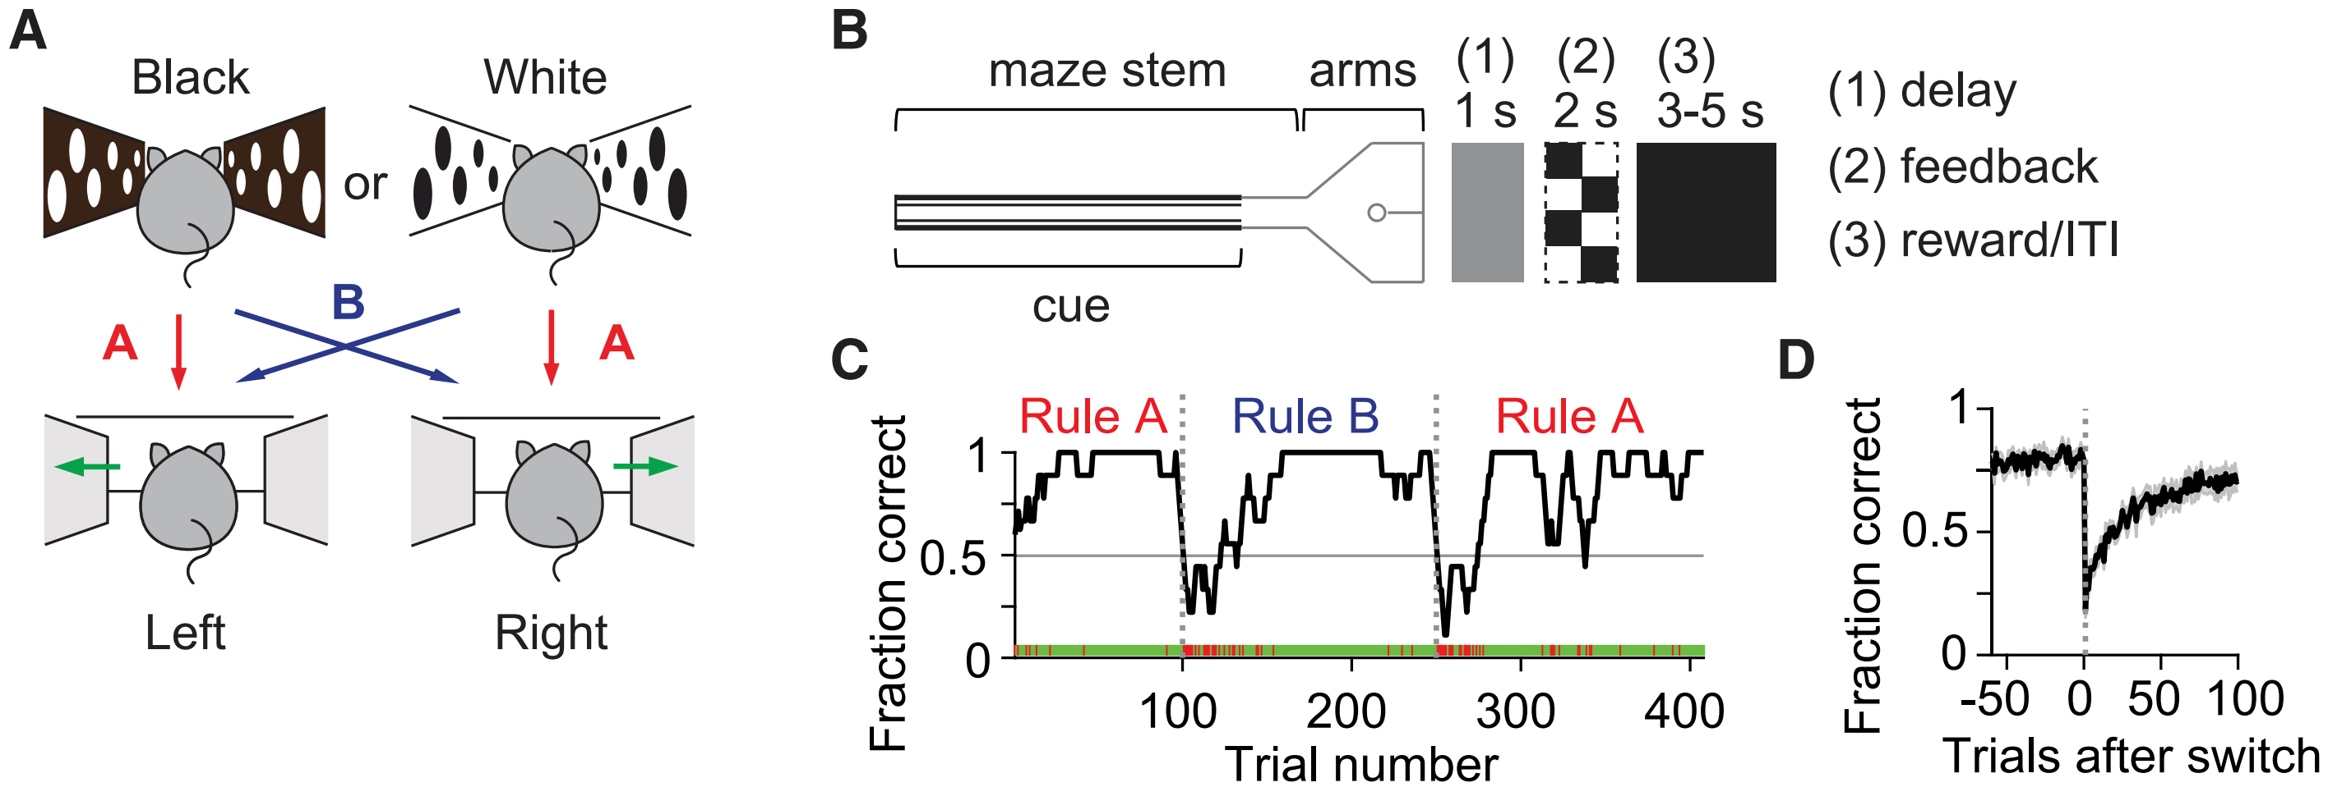
Walk-thru concrete neuro example 2: 2022 Tseng
Example 2: Fitting data from mouse posterior cortex
GLMs can also be used to characterize tuning in dynamic tasks with nontrivial structure!
See also tutorial slides by Shih-Yi at:
https://github.com/sytseng/GLM_Tensorflow_2
Tseng and Chettih et al., Neuron (2022)

Slide 17
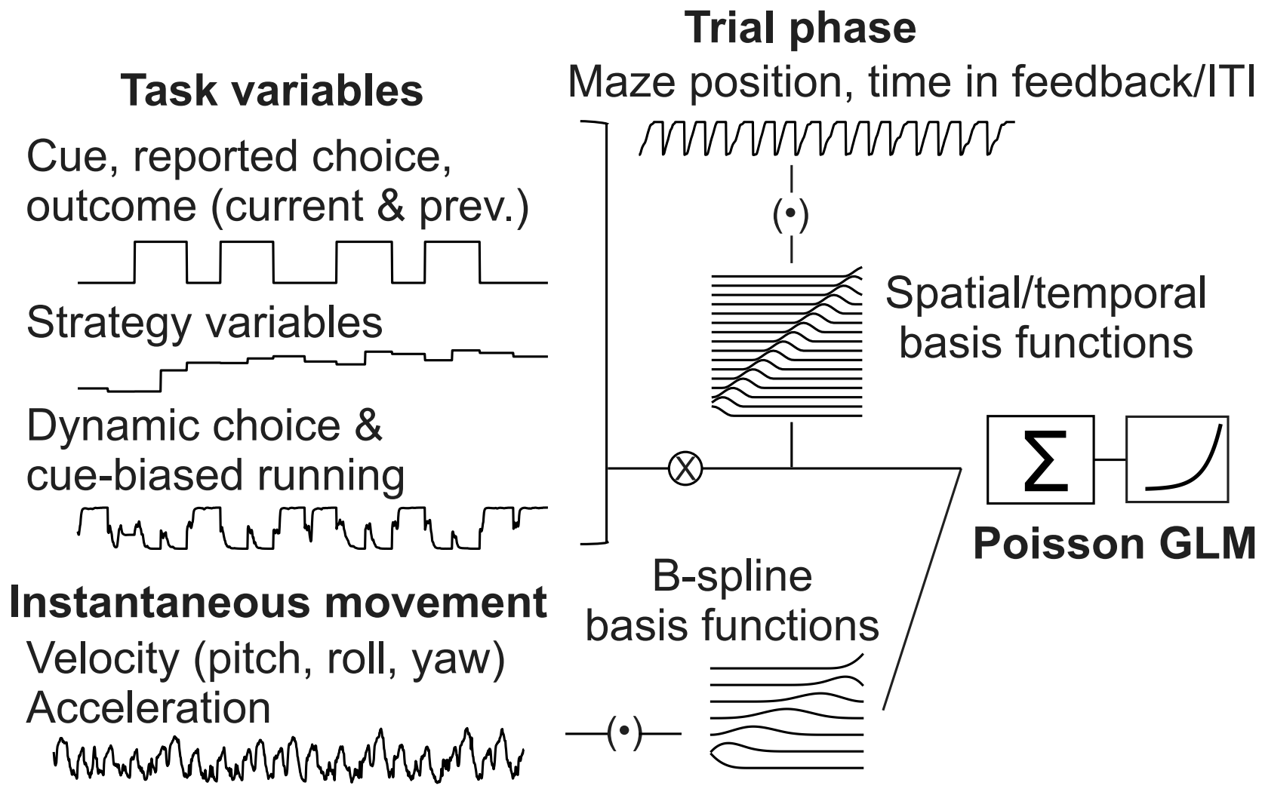
Walk-thru concrete neuro example 2: 2022 Tseng
Example 2: Fitting data from mouse posterior cortex
Much more complex for a few reasons:
1. Multiple categories of variables are relevant.
Dynamic navigation involves tracking:
Movement (e.g., velocity), time (e.g., task phase),
belief (go left or right?), strategy (e.g., be lazy?) …
2. Time-dependence of firing rates is important.
e.g., evidence accumulation occurs over time,
address using temporal basis functions
3. Parameter smoothness via state representation.
address using smooth basis functions instead of via regularization

Slide 18
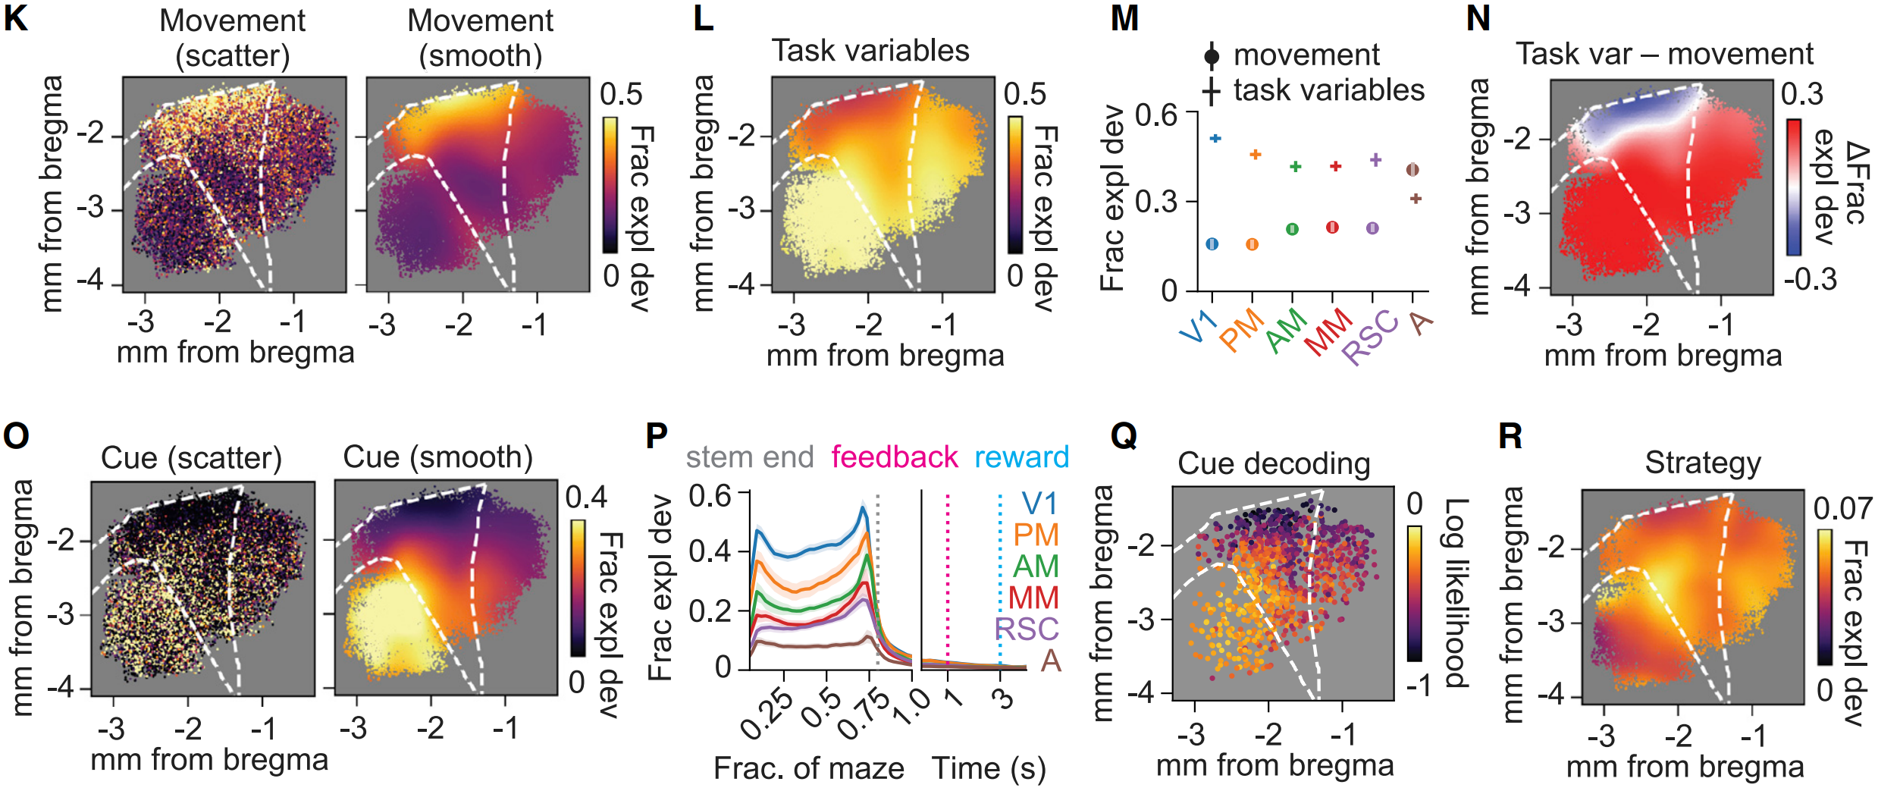
Walk-thru concrete neuro example 2: 2022 Tseng
Example 2: Fitting data from mouse posterior cortex

Slide 19
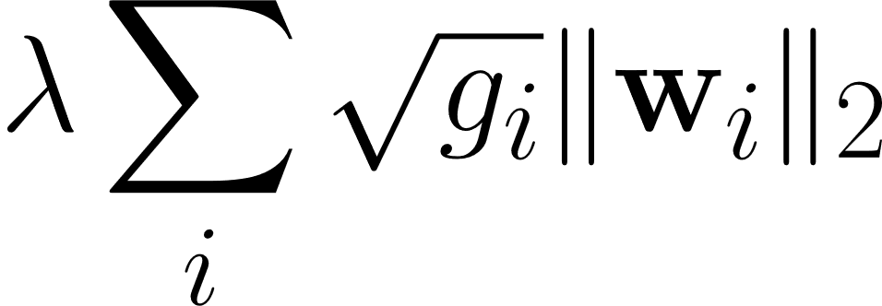
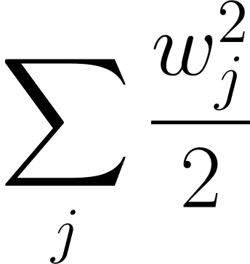
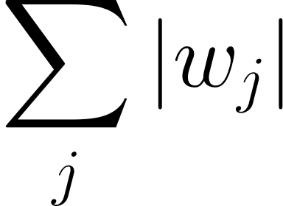
Walk-thru concrete neuro example 2: 2022 Tseng
Example 2: Fitting data from mouse posterior cortex
Important fitting detail:
Number of parameters is HUGE (~ > 1000 per neuron), so model highly underconstrained.
Tseng et al. used a group lasso penalty to regularize the model:
Idea: “encourages sparsity between tuning to different variables,
but non-sparse L2 regularization on the within-variable bases”
Can also use some
combination of:
encourages
small magnitudes
encourages
sparsity

Slide 20
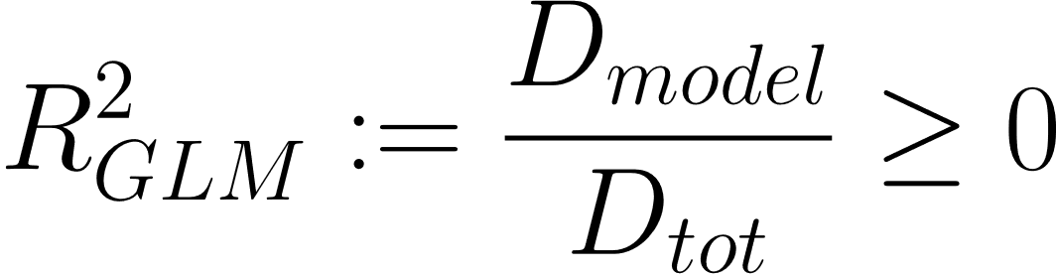
Example 2: Fitting data from mouse posterior cortex
Q. How do we measure goodness-of-fit?
For Poisson regression, better to use “Poisson deviance” than squared error.
Can also consider a quantity analogous to “variance explained”: deviance explained!
(see lecture notes for more details)
Idea: Compare fitted model to two extremes. One extreme: only fit mean of data. (null model)
Other extreme: # parameters = # data points (saturated model)

Slide 21
Example 2: Fitting data from mouse posterior cortex
Q. How do we choose hyperparameters (e.g., regularization strengths)?
Can’t just check which parameter fits better on test set!
(because then you’re using the test set as a training set…).
Instead, can use a strategy like k-fold cross validation.
Split the training data up into pieces, and test model fits on one piece against fits on other pieces.

Slide 22
Example 2 Takeaways
- Complex state representations allow GLMs to capture complicated spiking dynamics
in a task that mixes dynamic navigation and decision-making.
On the other hand, additional model complexity has predictable tradeoffs,
re: interpretability, time required to fit model, etc.
- Very large number of parameters means careful model selection is crucial.
In practice, ought to use tricks like regularization, k-fold cross-validation, etc…
Be careful about measuring goodness-of-fit; deviance more appropriate than squared error!
See Shih-Yi’s GitHub repo for a research-level implementation of GLMs
https://github.com/sytseng/GLM_Tensorflow_2

Slide 23
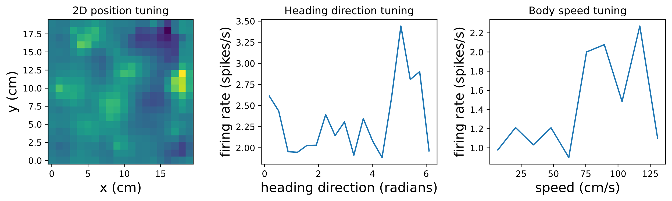
Coding exercise: your turn!
https://github.com/DrugowitschLab/ML-from-scratch-seminar
Goal: Train Poisson GLM to fit data from 4 mouse MEC neurons
Data from Mallory and Hardcastle et al., Nat Comm (2021)
https://figshare.com/authors/Lisa_Giocomo/9864194

